Slide 1

Period 1 Review (1491 - 1607) in 10 Minutes
Shoutout to Mr. Cirbo’s class. Thanks for your support! Good luck, you’re brilliant!
Everything You Need To Know About Period 1 To Succeed In APUSH

Slide 2
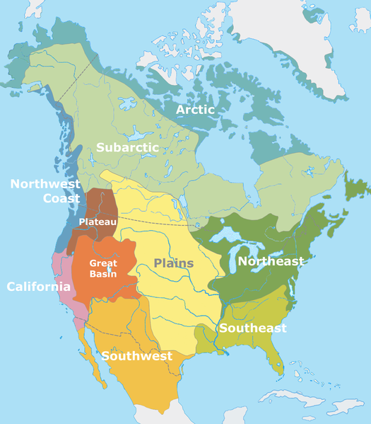
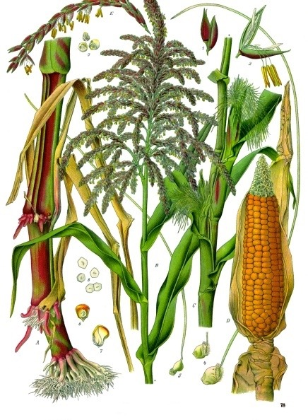
Native Americans Pre-Contact
Maize (corn) was a significant food source in present day Mexico and SW US
NW US - Natives hunted, fished, and foraged
Great Basin and Plains - predominantly hunting - lack of natural resources
NE US - mix of agriculture and hunting

Slide 3
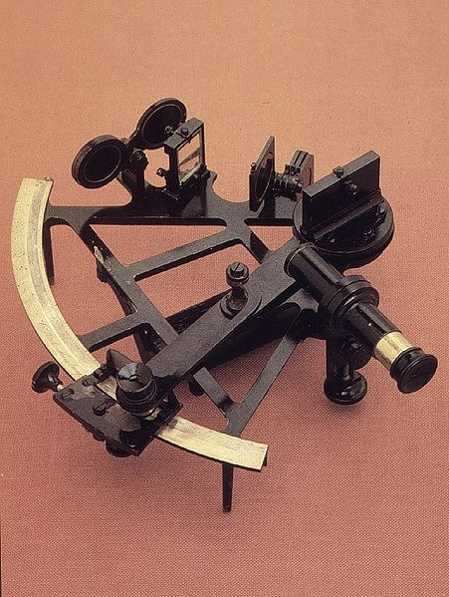
European Exploration Goals
Technological Improvements that helped promote contact and trade?
Sextant
Joint-stock companies
Reasons for Exploration?
Wealth (gold), Power and status (glory), and spread Christianity (God)

Slide 4
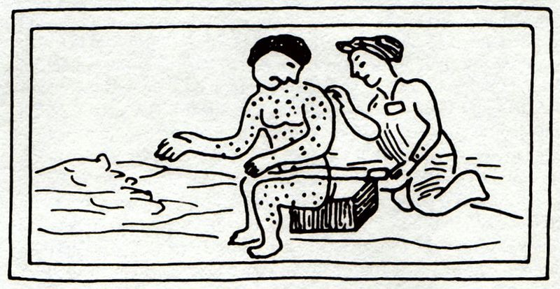
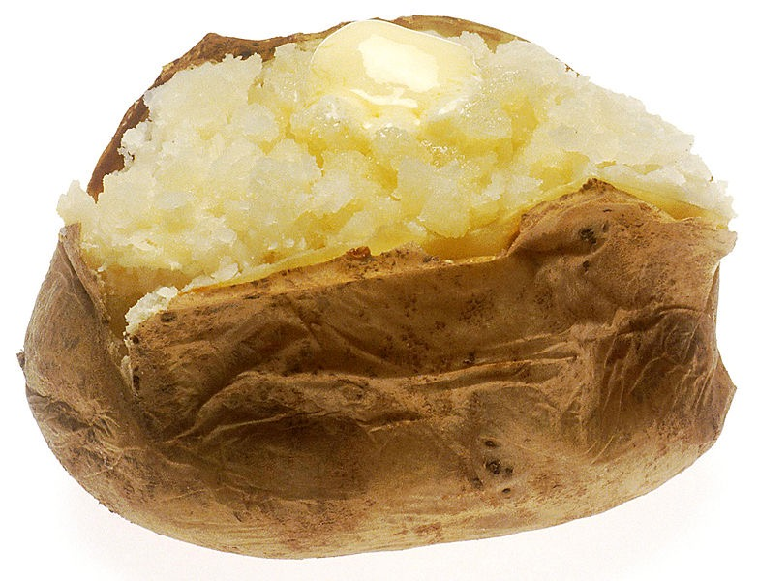
European Contact
Columbian Exchange:
Exchange of goods, ideas, people, and diseases between Europe, Africa, and the Americas
Impact on Europe?
Population growth (corn, potatoes)
Shift from feudalism to capitalism
Impact on Natives?
Diseases killed many
Horse and guns transformed way of life (hunting, warfare)
Impact on Africans?
Increase in slave trade (Portuguese and Spanish in West Africa)

Slide 5
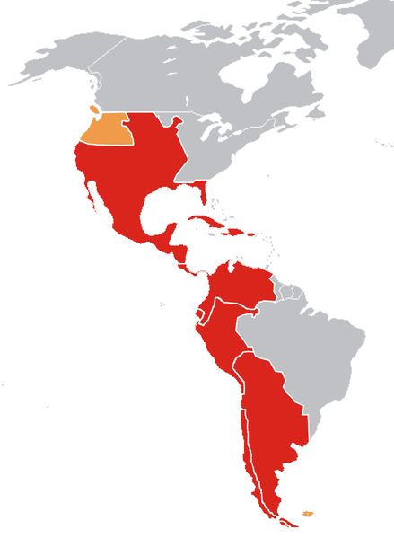
The Transformation of the Americas
Impacts of Spanish contact:
New caste system and racially diverse populations
Mestizo - mixed Spanish and Native ancestry
Mulatto - mixed Spanish and African ancestry
Encomienda System (16th Century):
Royal grants of land from Spanish crown to Spaniards
Spanish settlers promised to Christianize Natives
Spanish gained tribute
How were Natives impacted?
Many were treated harshly
Heavy manual labor - building roads and infrastructure
Eventually, the system was replaced by African slave labor

Slide 6
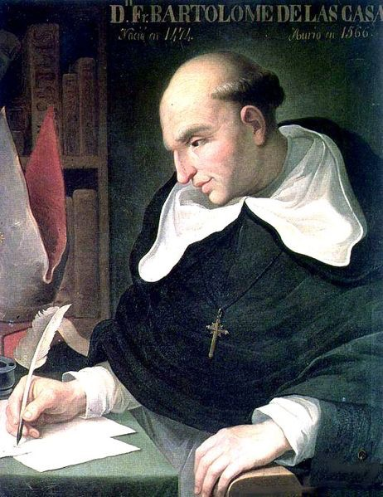
The Transformation of the Americas
Debates over treatment of Natives:
Bartolome de Las Casas
How was treatment of Africans and Natives justified?
White superiority, religion, “uncivilized” view of groups
Conflict with Natives:
Europeans sought to change Natives’ way of life and worldview
Natives sought to preserve **autonomy** (independence or self-rule)
Africans adapt to the Western Hemisphere:
Sought to preserve **autonomy**
Combined Christianity with African religions
Maroon communities - made up of runaway slaves
Bartolomé de las Casas

Slide 7
Quick Recap
Native cultures prior to contact
Maize
Reasons for European exploration
Goals of Europeans
**Columbian Exchange - impacts on three continents**
European justification of treatment of Natives and Africans
Encomienda System
Natives and Africans sought to preserve some level of autonomy

Slide 8
Short Answer Practice
Answer all 3 parts
European interaction with the Western Hemisphere drastically changed life for all those involved.
a) Briefly explain one reason for European exploration
b) Briefly explain one impact of European exploration on the Americas
c) Briefly explain one impact of European exploration on Europe

Slide 9
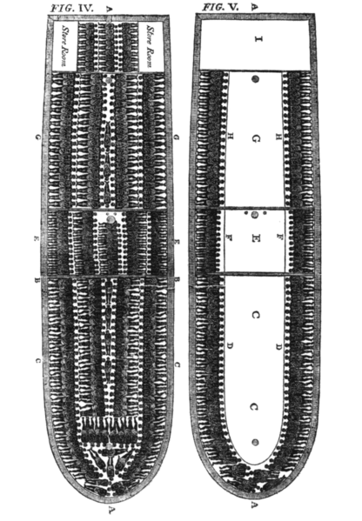
See You Back Here For Period 2 In 10 Minutes!
Thanks for Watching
Please subscribe, share with others
Check out all my videos related to the new curriculum
Best of luck on all your tests!

